Slide 1
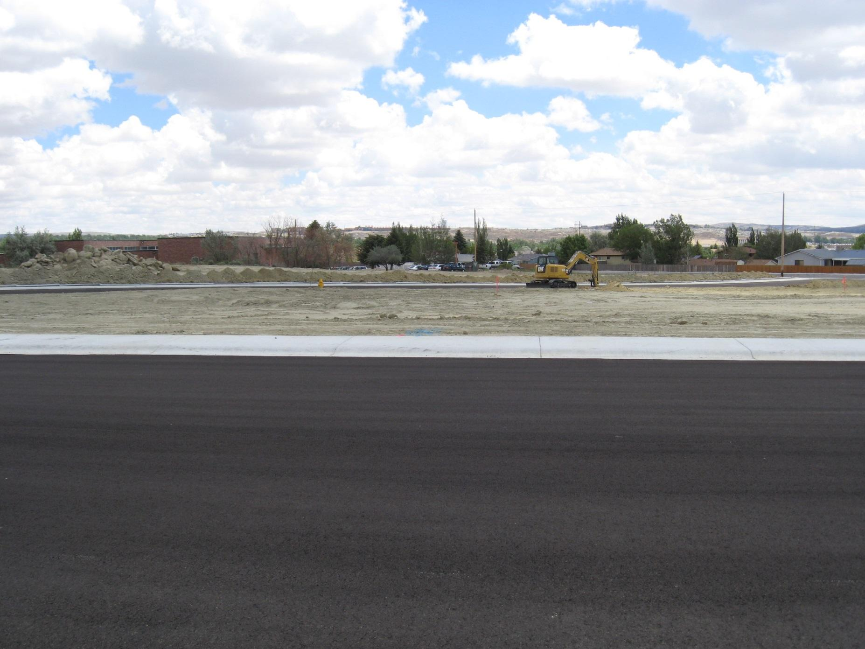
BEING READY FOR AN INSPECTION
No matter when the inspector shows up.
Notes:
So we know that the inspector showing up isn’t a contractors favorite event, but there are some things you can do to make it easier on everyone.

Slide 2
Objectives
Know What Is In The Permit
Know How to Develop a Compliant SWPPP and Keep It Compliant.
Being Ready For An Inspection from the DEQ or the City.
Avoiding Common Pitfalls and Violations
Notes:
Here are the goals for this section of today’s workshop. Please feel free to ask questions as we go along or if you don’t want to ask aloud write it down on a sticky and post it to the Parking Lot.

Slide 3
Know What Is In The Permit
Just getting the permit isn’t the end. You need know what is in it so you stay in compliance.
Use the permit and your neighbors to find the answers to the questions on the next few slides.
Notes:
Many times we see permittees write the SWPPP (or have a consultant write the SWPPP) get their permit, and not ever take a look at either one again. Save yourself time, money, and hassle know what is in your permit and SWPPP.
The permit are the rules you legally agree to follow and the SWPPP is what you say you are going to do to follow the rules. Just because you don’t know is not a defence against violations and enforcement.

Slide 4
Use the permit to answer the question. Write the page number and section number you found the answer on.
1. You are done with construction and want to terminate the permit, but have been told the site must be “Finally Stabilized” what do you have to do to reach final stabilization?
2. What are 3 signs of visible or measurable erosion?
3. When sediment is tracked from a construction site to paved areas how long does the company have to remove that tracked sediment from the pavement?
4. What are 4 prohibited water discharges according to the permit?
5. When should you make changes to your SWPPP?
Notes:
So let’s take a look at the permit with a little game of search…
give 5 minutes
1. Page 3 2.8
Page 11 7.4
Page 12 7.7.
Page 15 7.18
Page 17 8.1.5

Slide 5
Use the permit to answer the question. Write the page number and section number you found the answer on.
6. Where should your SWPPP, Letter of Authorization, and copy of the Permit be?
7. How long do you have to provide the SWPPP when it is requested by someone in the WQD?
8. How big does a secondary containment unit have to be for a bulk fuel tank?
9. How often do inspections need to occur for an active construction sites?
10. If a self inspection has no problems and is found to be compliant with the SWPPP what must be on the inspection report?
Notes:
Give 5 minutes
6. Page 17 8.1.6
7. Page 17 8.1.6.2
8. Page 22 8.2.4.3.b.3
9. Page 23 9.2.1.1
10. Page 24 9.7.7

Slide 6
What to expect during an inspection and how to be ready.
Record Review
What you should have on site.
LOA, Permit, SWPPP, Inspection Documentation
Common issues/ violations.
Common Plan of Development/ Permit Status
Field/ Site Inspection
BMPs
Common Issues
Notes:
There are two parts to a construction storm water inspections, and it doesn’t matter if it is LC or SC

Slide 7
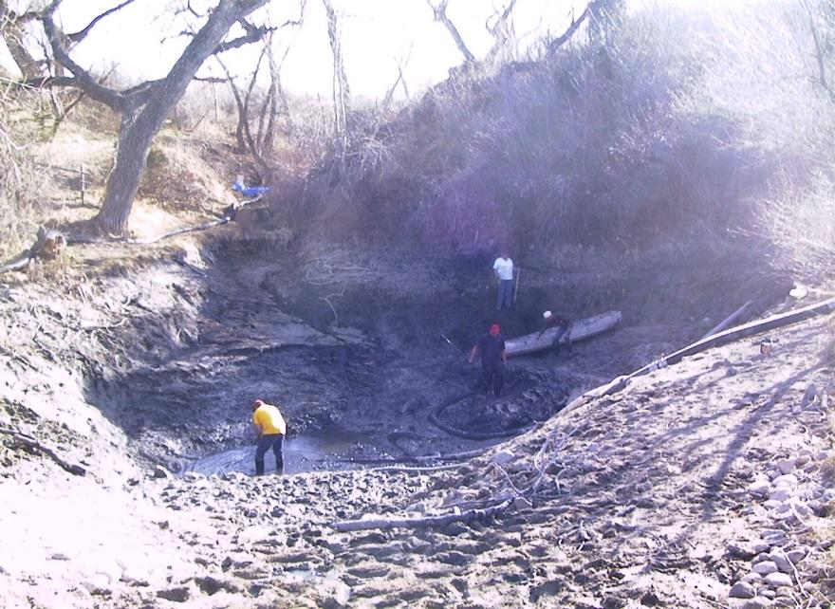
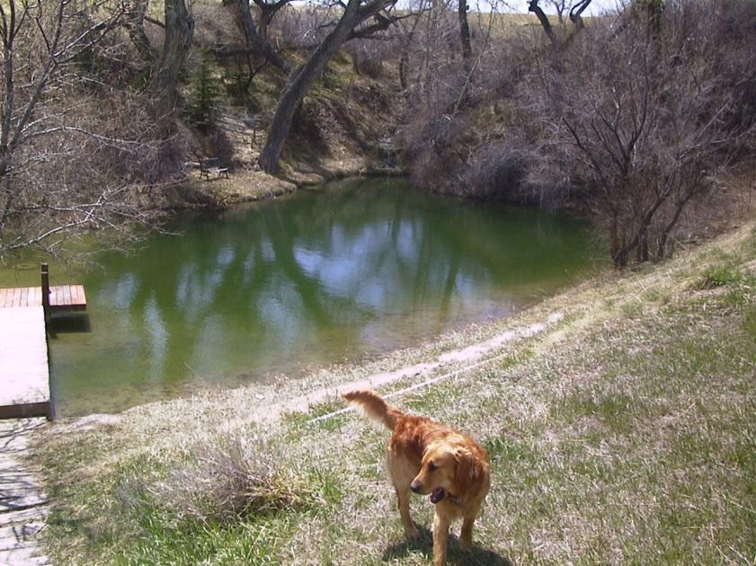
Problems with paperwork…
1
What’s the point of the SWPPP, and why does the DEQ care about it?
2
3
Notes:
First the Records Review
On site you must have a copy of the LOA, the permit, the SWPPP, the site map (part of your SWPPP) and you self-monitoring inspection reports.
The SWPPP and the inspection reports are the two most important documents to have during the inspection.
The SWPPP will help you avoid major problems like shown in these pictures.
The neighbors fishing pond before construction on adjacent land.
There were no BMPs to prevent erosion and sedimentation from the construction site, so runoff filled the fishing pond with sediment. Photo 2 is the contractor recovering all of the sediment they lost from their site.
3. The after picture of the fishing pond resulting in thousands of dollars lost by the contractor that could have been avoided with a good SWPPP and some good BMPs.

Slide 8
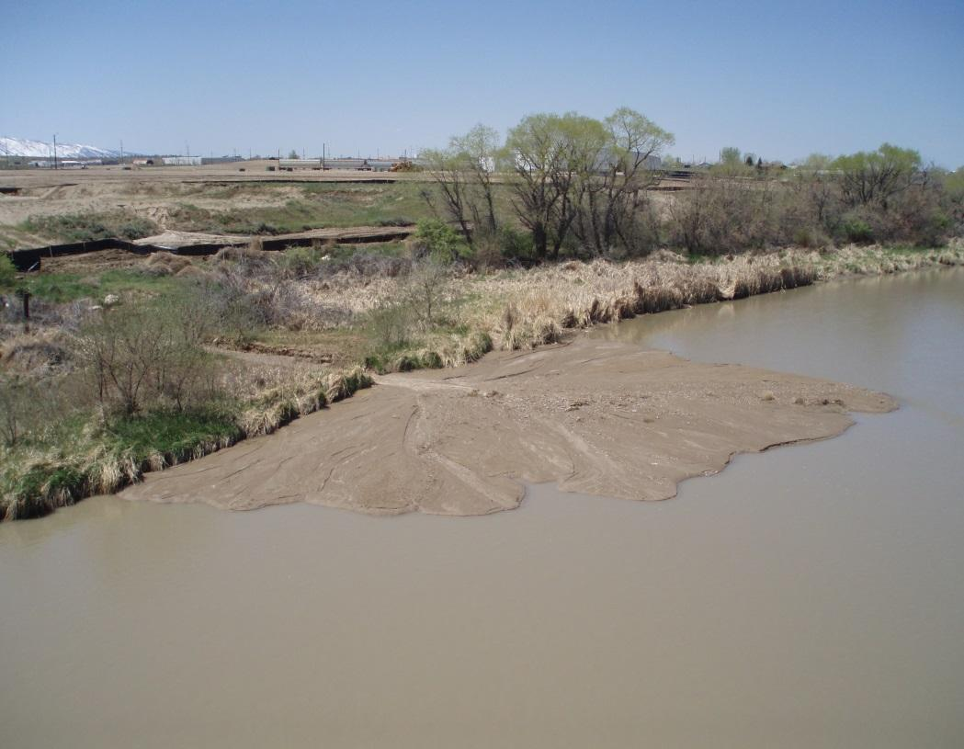
The SWPPP is your plan to avoid these problems?
Avoid Fines
Avoid infrastructure Damage.
Avoid polluting water we all want to enjoy.
Notes:
You are basically responsible for any damage caused by your construction project. In addition to paying for damages you can face fines and other penalties.
One of the best ways to avoid this is to have a good plan (SWPPP) in place that meets the permit requirements and to follow it.

Slide 9
What Information is required in the SWPPP? Section 8.2
Section 8.2.1- SWPPP Administrator
Section 8.2.2- Site Description.
Section 8.2.3- Site Maps
Section 8.2.4- Best Management Practices (BMPs)
Section 8.2.5- Maintenance
Section 8.2.6 – Inspections
Section 8.2.7 - Signature
Have a plan to avoid costly
Failures.
Notes:
These are the basic requirements of the SWPPP. As we go through this presentation we will be following the SWPPP template available on the DEQ’s website. It is not a requirement that the template be used, but the template if filled out in detail meets all of the requirements of the permit. You also have a copy of the template you can refer to as we go through this.

Slide 10
Section 8.2.1
The person or persons responsible for developing the SWPPP, maintaining the SWPPP, and adhering to the SWPPP must be identified by either NAME or POSITION. (This includes those who will be responsible for BMP maintenance and inspections)
Mistake #1 not identifying people responsible for assigning duties to people not identified in the SWPPP.
SWPPP Administrator
Notes:
Make sure you designate who will be responsible in this section. (Identify your team) If something changes during the project (One of the team leaves or you would like to add another person) change the SWPPP. As we go through this today you will hear change the SWPPP a lot. It is not a one time document. It needs to change as the project changes.

Slide 11
Section 8.2.2
8.2.2.1 – Nature of Construction Activity
8.2.2.2 - Major Activity Sequence.
8.2.2.3 – Site Area Estimate
8.2.2.4 – Support Activity Discharges.
Narrative Site Description
Notes:
All of these parts are required to have an adequate narrative site description.
What kind of construction are you doing? For what?
For the major activity sequence when the SWPPP is first written these are estimates, but how often do construction projects follow the exact timeline in your plans?
As you complete each of the major activities write down a date of completion in this section of the SWPPP.
How big is your site?
Support activities are things like concrete batch plants on site that are covered under this permit.

Slide 12
SWPPP Template
Notes:
So take a look at the SWPPP template in front of you are there any questions about what to put in this section.
Remember to be detailed in your descriptions.

Slide 13
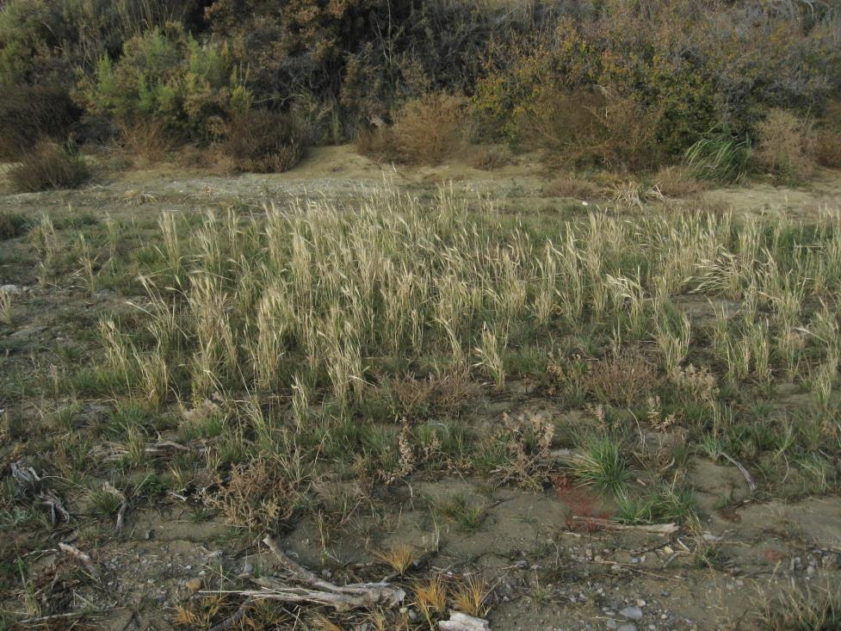
Section 8.2.2.5
A Brief Description of Existing Vegetation
Be Specific and Give % Estimation.
Background
Regrowth
Notes:
Why is background vegetation important and how do you estimate it?
When it comes time to terminate the permit you must have reach final stabilization and for all areas covered in vegetation that means that your vegetation must be 70% of what it was before disturbance or background.
Does anyone have simple tips they have used to determine this?

Slide 14
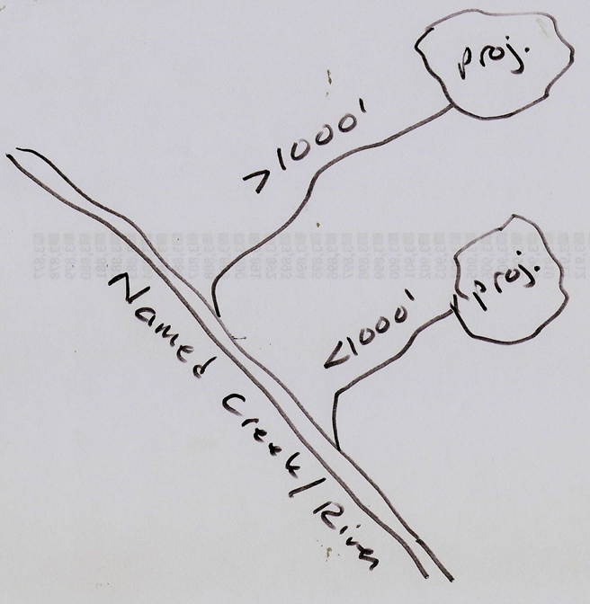
8.2.3 Site Maps
Must contain:
North arrow
Any surface waters
Areas of disturbance
Areas left undisturbed
Storage areas
Concrete washout areas
E & S controls.
Support activity areas covered under this permit.
SW drainage patterns.
SW discharge points.
Must be revised EVERY time you make changes to the site
Notes:
The most common issue with site maps is that they aren’t current to project conditions ...

Slide 15
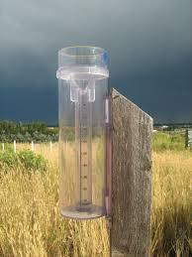
8.2.4 Best Management Practices
Must withstand and function properly up to a 2 year – 24 hour storm event.
Notes:
You have the burden of proof if you feel a storm event has exceeded the 2 year 24 hour. You can either use nearby meteorological data or have an on site rain gauge. The 2 yr 24 hr event different in different parts of the state.

Slide 16
SWPPP Template
Notes:
This is an area of the SWPPP that I often see a lack of detail, and some confusion about what is being asked for. This is key to preventing major site issues, so we will address not only the paperwork, but common site issues as well.

Slide 17
Erosion Prevention BMPS
Erosion controls are designed to keep sediment from moving.
Preserving existing vegetation
Scheduling
Surface roughening
Permanent or temporary seeding
Mulches, tackifiers, erosion control blankets.
Wind erosion control
Storm water diversion
Pipe slope drains
Outlet protections.
Notes:
Preserving as much vegetation for as long as possible will really help reduce erosion, and you will end up spending less on BMPs.
Just because we are talking about water doesn’t mean wind doesn’t come into play. Wind erosion is addressed inthe permit because it can contaminate water. It is also one of the common complaints from neighbors. If you are not on site working on a windy day you need to still address wind erosion. Don’t make your neighbors unhappy.

Slide 18
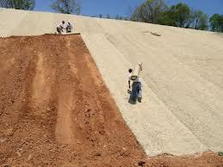
Erosion Control Devices
The best erosion control device is to preserve vegetation for as long as possible.

Slide 19
SWPPP Template
Notes:
Sediment controls are different from erosion controls, and we shouldn’t see the exact same thing for both in your SWPPP.

Slide 20
Sedimentation Control
Sediment controls are to keep sediment that has moved from its original spot from leaving the site and entering waters of the State.
Sediment barriers like, straw bales, wattles, gravel berms, silt fences.
Sediment traps and basins
Storm drain inlet protection.
Track out controls.
Undercut lots near curb and gutters.
Vegetative buffer strips.
Water bars and water wings.
Grassed waterways.
Notes:
Typically we think of sediment controls when we picture BMPs on a construction site. Not all sediment controls work equally well in every situation/ spot.
If a sediment control isn’t working change it, and change the SWPPP.

Slide 21
Sediment Barriers
Notes:
They need some erosion control at this spot, but you can see the straw waddles provide some protection for the stream below.

Slide 22
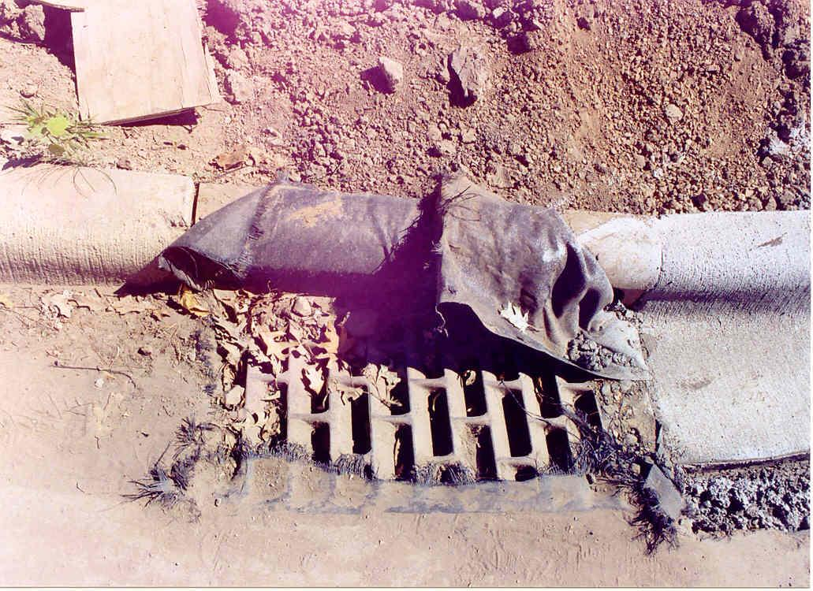
Inlet Protection?
1
2
3
4
Notes:
Give me a show of fingers for your answer. Which of these inlet protection devices is not adequate inlet protection.
#1
Inspector eye candy…
Why?

Slide 23
SWPPP Template
Notes:
If your site or a part of your site will be inactive for 14 days or more it must have either temporary or permanat stabilization.
So what are we looking for here?

Slide 24
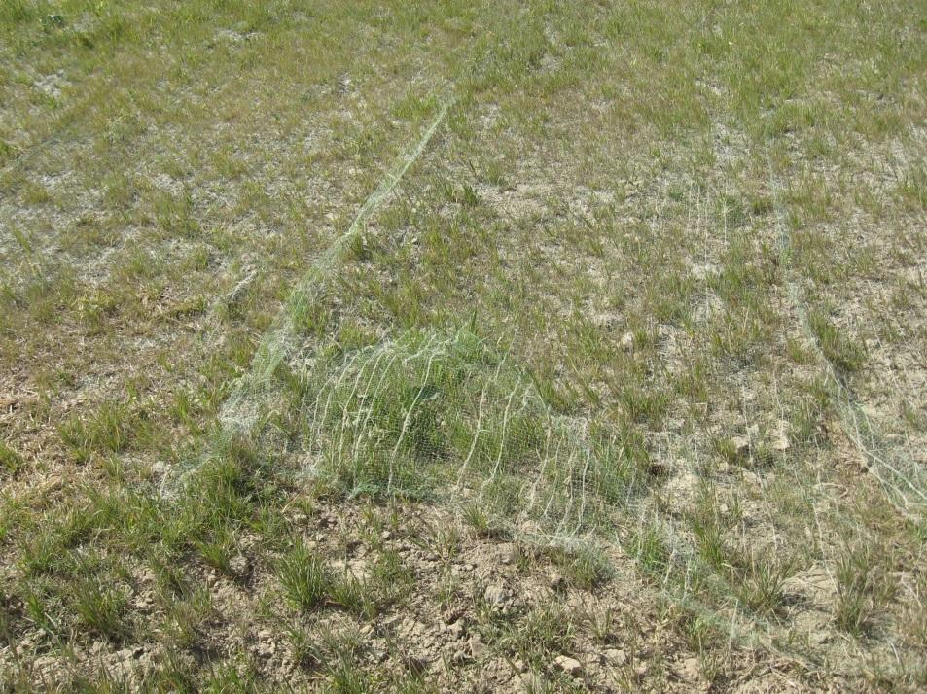
Stabilization Measures
Essentially Erosion Control.
Notes:
In this section of the SWPPP you need to put in what you are going to do to keep soil from eroding when construction is no longer active. Some examples are seeding, mulching, crimping straw in.
If the home is finished the City of Casper has some requirements for landscaping.

Slide 25
SWPPP Template
Notes:
In this section of the SWPPP be specific, and avoid some common pitfalls.

Slide 26
8.2.4.3 Operational Controls
Good Housekeeping
Bulk Storage
Concrete washout
Employee training
Sanitary Facilities
Notes:
Good housekeeping is how you keep the site clean. What do you do with the trash etc.
Bulk storage is how you will handle any chemicals and fuels on site. these include paints, paint thinners, etc.
We will talk a little more about concrete washout, but until it has dried and hardened concrete is a potential pollutant and washout must occurr in appropriate places.

Slide 27
Good Housekeeping and Wyoming.
Notes:
Does anyone see a problem with the first dumpster?

Slide 28
Bulk Storage
Notes:
There are several options for secondary containment of fuels. Two of the most common are the stock tank and the lined gravel berm. Remember that the secondary containment unit must be large enough to hold the volume of the largest container plus 10% for a minimum of 72 hours.

Slide 29
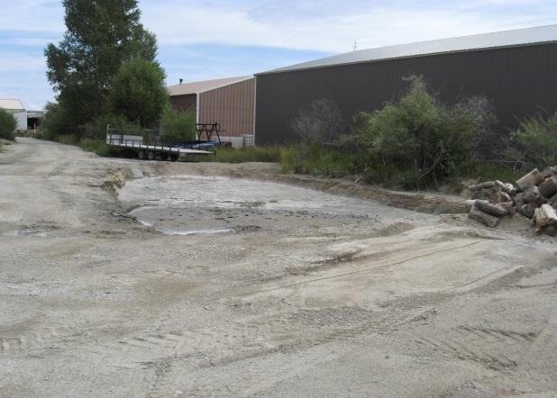
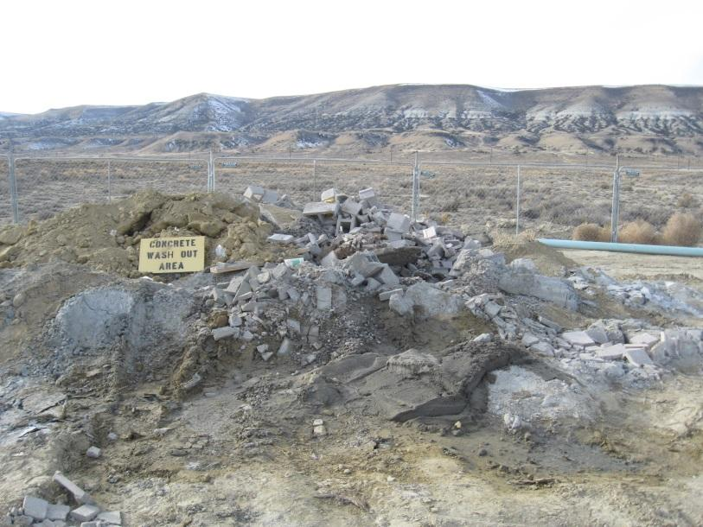
Concrete Washout
1
2
3
4
Notes:
Show of fingers. Which of these concrete washout sites is best? Why

Slide 30
Which sanitary facility is in compliance?
1
2
Notes:
Show of fingers Which sanitary facility is most appropriately sited? Why?
Why in Wyoming would you want to stake down your sanitary facilities? Do any of you have teens? Anecdote about locking people in them and tipping them over.
Put them on dirt if possible and secure them.
Place them as far from storm drains, drainages as possible.

Slide 31
SWPPP Template 8.2.5
Notes:
For each BMP you must include its maintenance schedule. It is best if you have the manufacturer recommendations in the SWPPP.
It is not good enough to say when it needs it.

Slide 32
Section 8.2.5 Maintenance
Must have a specific maintenance plan for every BMP.
Maintenance and installation must meet manufacturers specifications.
When possible include manufacturer installation and maintenance instructions with the SWPPP

Slide 33
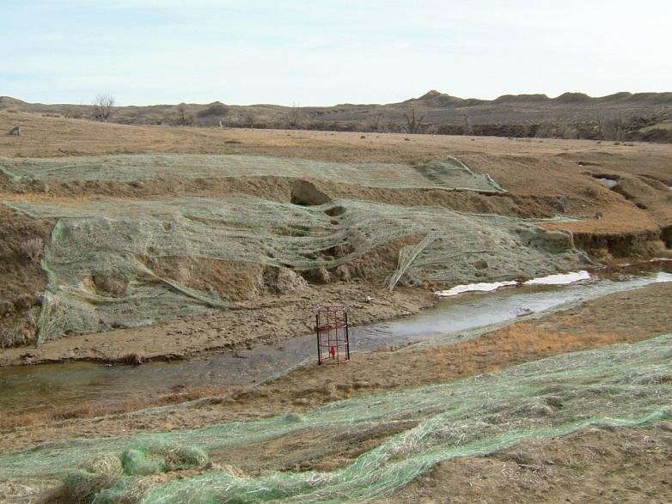
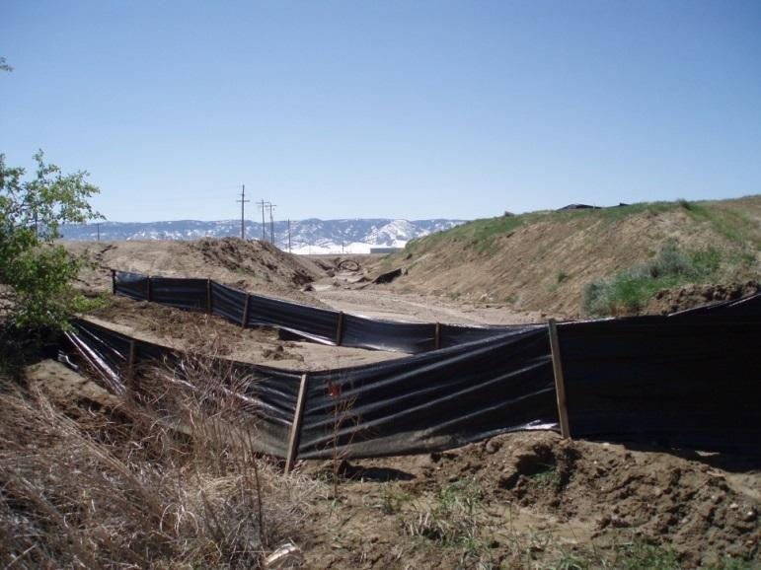
Even the Best BMPs don’t work if you don’t install them correctly and maintain them!!!
1
2
3
4
Notes:
Was a sand bag that was destroyed and never replaced
A sediment trap bag that was not maintained filled with sediment, and during a storm the street flooded and the sidewalk/street around the catch basin collapsed.
Erosion control blankets that are not doing anything.
Silt fence

Slide 34
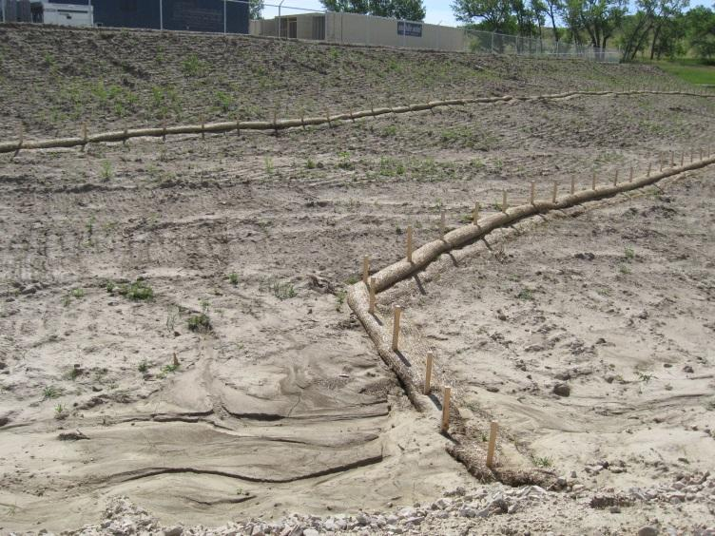
Even the Best BMPs don’t work if you don’t install them correctly and maintain them!!!
1
2
3
4
Notes:
Installation issue
2. Needs maintained
If any sedmient control device is over half full of sediment the sediment needs to be dug out.

Slide 35
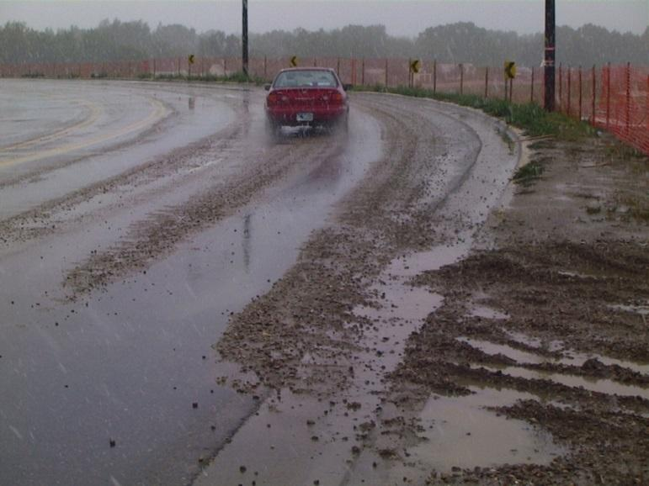
Even the Best BMPs don’t work if you don’t install them correctly and maintain them!!!
1
2
3
Notes:
2. A track pad that is doing nothing there is still sediment all over the street.
3. Too small of rock used if you can even call this a track pad.

Slide 36
SWPPP Template 8.2.6
Notes:
Know how often you have to inspect for both active and inactive construction sites. What ever you write down must meet permit requirements and you are legally bound to follow this schedule.

Slide 37
Inspections
Inspection Reports (see Part 9.7)Within 24 hours of completing each inspection, you are required to complete an inspection report that includes:
Date/ Time of inspection;
Names and titles of persons conducting the inspection;
Summary of inspection findings;
Corrective actions taken
Dates and amounts of precipitation events that exceed 0.5 inches in a 24 hour period.
Documentation of any changes made to the SWPPP and SWPPP site map.
A statement indicating whether the site complies with the SWPPP or not.
The inspection report must the SIGNED and CERTIFIED.
Requirements
Notes:
I have provided a copy of a template adapted from NPDES that you can use. Just like the SWPPP template you are not required to use it, but it contains all the information required in the permit.

Slide 38
8.2.6 Inspections
Common Errors
Inspections not being conducted
Inspections are conducted on a different schedule than what is written in the SWPPP.
Special inspection pen.
Lack of Compliance Statement.
Inspection not certified.
Inspection not signed.

Slide 39
8.2.7 and 9.7.8 Certification and Signature
Notes:
Don’t forget these two essential pieces.
Certification statement must be word for word.

Slide 40
Overview of Common Paperwork Issues
The SWPPP is not current to project conditions.
The SWPPP lacks appropriate detail to be a good plan, and give a decent idea of what is in place on site.
The SWPPP site map has not been updated.
The self-monitoring inspections reports are not signed and certified.
Lack of specific maintenance schedule for BMPs. (Include Manufacturer recommendations.)
ENDING permit coverage prior to final stabilization.

Slide 41
Overview of Common Site Issues
Not using the right BMP for the job.
Improper installation of BMPs
BMPs not being maintained
Lack of BMPs.
Not cleaning sediment and dirt ramps off sidewalks and paved surfaces at the end of each work day.
Sediment tacked onto paved surfaces.
SOLD lots are not in compliance with the SWPPP, and have not been stabilized.

Slide 42
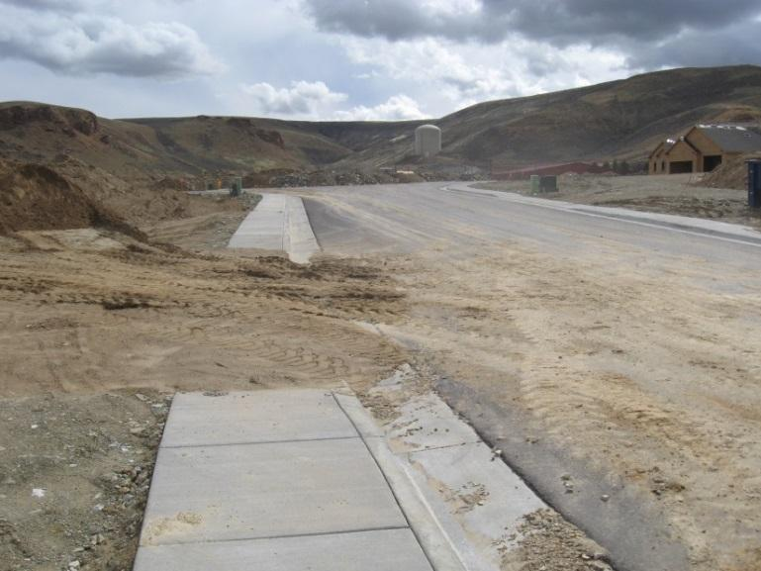
Dirt Ramps
Appendix C – 1.3
All dirt ramps over sidewalks to facilitate access across the sidewalk must be removed at the end of EACH construction day.
Notes:
Finally a pet peeve. I know why contractors use the dirt ramp, but most of the contractors I have seen leave these up for days/ weeks/ months. Unless you are willing to have your crew clean it up at the end of every day find a better way to protect the sidewalks from heavy equipment.

Slide 43
City of Casper Inspection
All construction activities for which a permit is required shall be subject to periodic inspections by the city manager or his designee.
A final inspection will be conducted at the request of the permittee after the construction activity is completed.
Final approval shall not be given until all work including installation of all drainage facilities and their protective devices, and all erosion-control measures have been completed in accordance with the permit.

Slide 44
Continued…...
No final approval shall be granted until permanent soil stabilization has been accomplished and permanent vegetation established.
City’s revegetation guideline;
http://www.casperwy.gov/userfiles/Servers/Server_62983/file/Resident/Environment%20and%20Waste/Stormwater/Revegetation%20Guidelines%20Handbook.pdf

Slide 45
Enforcement
If it is determined that soils are leaving a disturbed area by wind or water erosion, such person may direct the permittee on the site to install any sediment and/or erosion controls deemed necessary.
A stop work order may be issued until all issues are corrected. No building permits or occupancy permits issued.
A permit may be suspended or revoked if permit is issued in error, incorrect information is supplied, or if permit is not being followed as described.
Or city crews may correct any issues and back charge the permittee.

Slide 46
Continued….
Permittee has 24 hours to take action once notice of violation is issued.
Any person found to be in violation shall be deemed guilty of a misdemeanor.
Each day such violation occurs shall be a separate offense.

Slide 47
Non-permit inspection authority
Chapter 13.49 - URBAN STORMWATER QUALITY MANAGEMENT AND DISCHARGE CONTROL
Any person engaged in activities or operations, or owning facilities or property which will or may result in pollutants entering stormwater, the storm drain system, or surface waters of the state shall implement best management practices to the extent they are technologically achievable to prevent and reduce such pollutants.

Slide 48
Last Thoughts
Read the permit
Follow your SWPPP and your city permit/ guidelines.
Understand your responsibilities under the common plan of development.
It’s easier to keep up as you go than to catch up due to an inspection from the DEQ or the City of Casper.
Being a good steward makes for happy neighbors.

Slide 49
Thank You and Links to Resources
Large Construction:
http://deq.wyoming.gov/wqd/storm-water-permitting/resources/construction-general-permits/
Small Construction
http://sgirt.webfactional.com/filesearch/content/Water%20Quality%20Division/Programs/WYPDES/sub/Discharge%20Permitting/Storm%20Water%20Permitting-Construction%20General%20Permits/WQD-WYPDES-Stormwater_Small-construction-general-permit%20_2013-06.pdf

