Slide 1
Construction and State Storm Water Permits
What does it all mean?

Slide 2
Overview
High altitude view of major permitting requirements before, during, and after construction for storm water discharges
Focus on subdivisions, but applies to all qualifying construction
State requirements of project operators
State requirements of the city

Slide 3
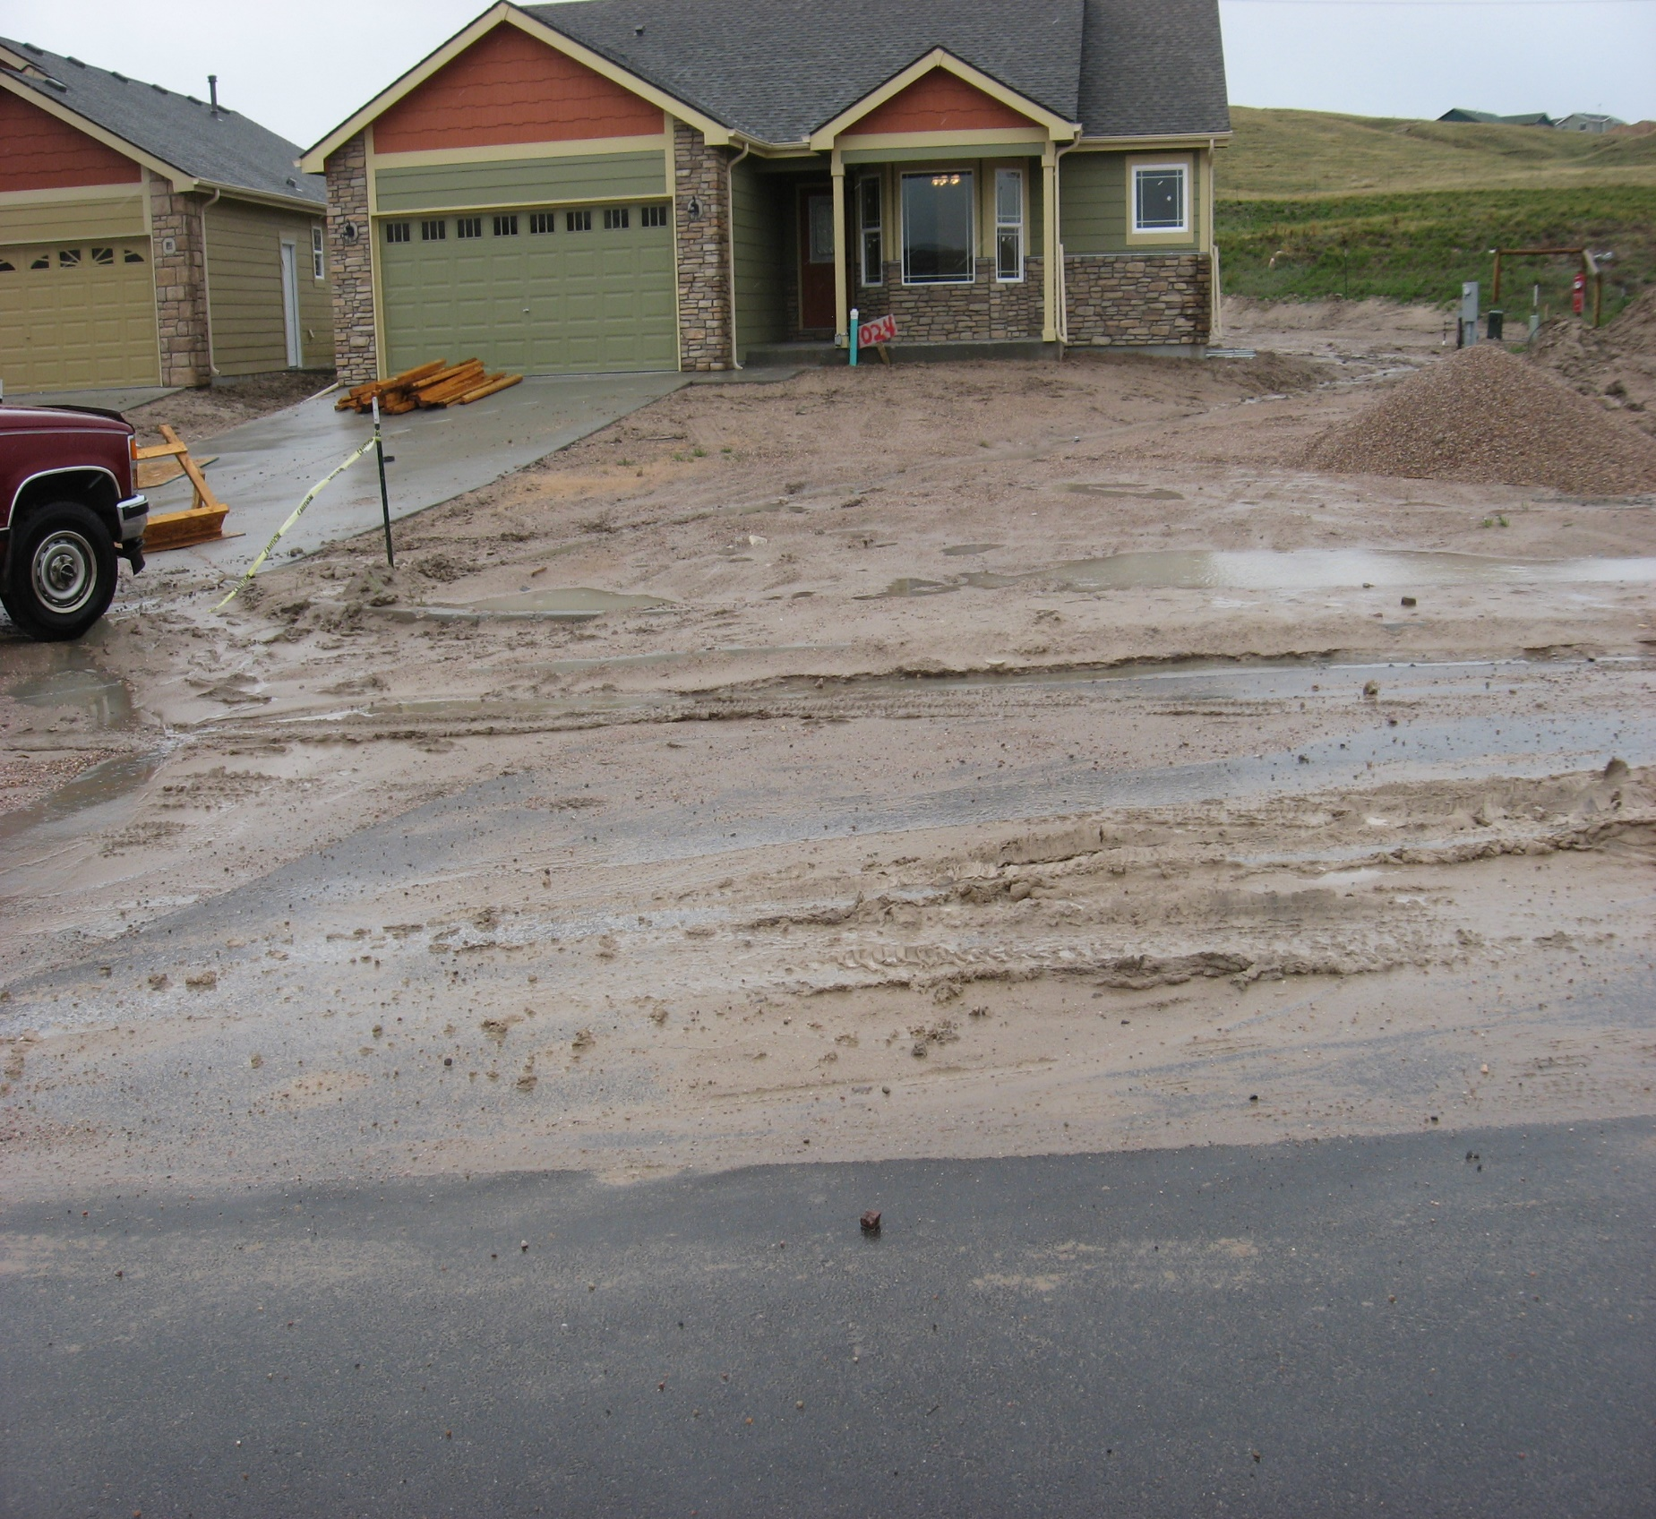
What’s it all about?
Protecting Wyoming’s surface waters from industrial pollutants.

Slide 4
What’s it all about?
Storm water permits are part of the federal Clean Water Act
  State of Wyoming has primacy here
Protect the quality of surface water through permits issued to certain construction, industrial, and municipal activities

Slide 5
What’s it all about?
Construction General Permits (CGPs) require a written plan that addresses all pollutants expected onsite and lays out Best Management Practices (BMPs) that the operator will use to keep those pollutants onsite.
Storm Water Pollution Prevention Plan (SWPPP)

Slide 6
SWPPP
SWPPP requirements in the permit
SWPPP should address all pollutants that could leave site in storm water
The SWPPP is enforceable

Slide 7
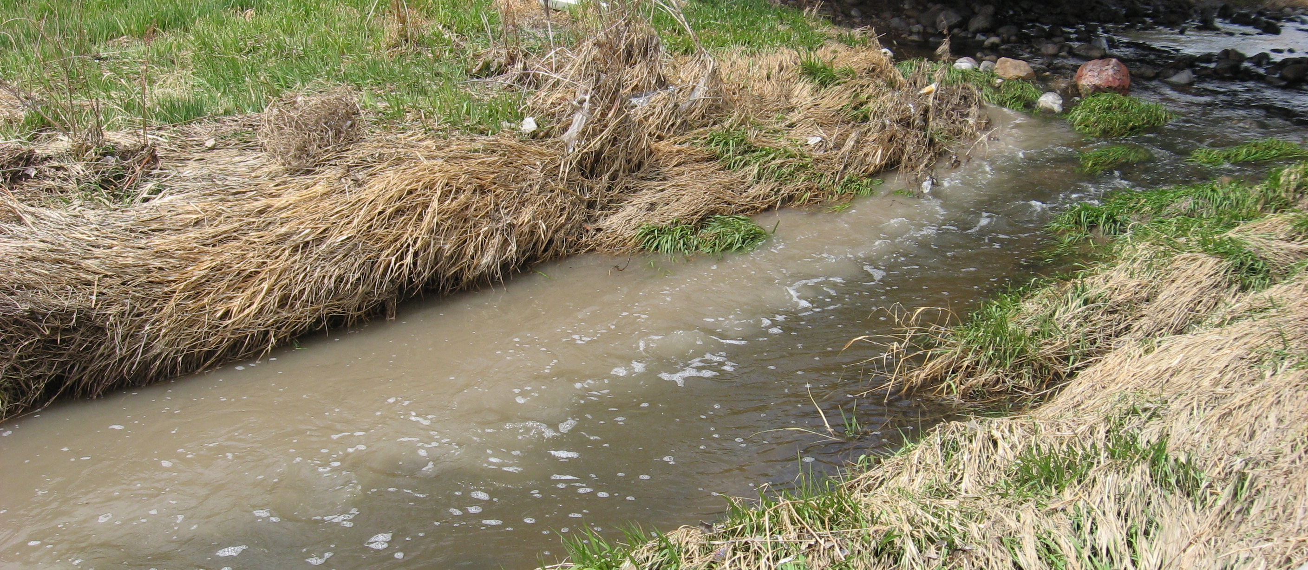
Construction General Permits
Who needs coverage?

Slide 8
Who needs a permit?
The “operator” of any construction activity that:
  Clears or disturbs 1 or more acres
    Not necessarily contiguous
  AND smaller projects that disturb < 1 acre, but are part of a “Large Common Plan of Development or Sale” that itself disturbs ≥ 1 acre
  Size of the *entire* project determines which CGP

Slide 9
Two Construction Permits
Large Construction General Permit (LCGP) for disturbance ≥5 acres and smaller disturbances that are part of a “common plan”
Small Construction General Permit (SCGP) for 1 to 5 acres and smaller disturbances that are part of a “common plan”

Slide 10
For Example…
0.5 ac | 0.5 ac | 0.5 ac | 0.5 ac | 0.5 ac
Happy Lane
0.5 ac | 0.5 ac | 0.5 ac | 0.5 ac | 0.5 ac
Developer Dan has cleared 6 acres for a road and utilities and 10 - 0.5 acre lots. What permit does Dan need?

Slide 11
For Example…
0.5 ac | 0.5 ac | 0.5 ac | 0.5 ac | 0.5 ac
Happy Lane
0.5 ac | 0.5 ac | 0.5 ac | 0.5 ac | 0.5 ac
Builder Bob buys one lot and will build a home.
Does Bob need coverage under a CGP?
Which permit?

Slide 12
For Example…
0.5 ac | 0.5 ac | 0.5 ac | 0.5 ac | 0.5 ac
Happy Lane
0.5 ac | 0.5 ac | 0.5 ac | 0.5 ac | 0.5 ac
Contractor Carl buys four lots. Does he need permit coverage? What kind?
There 3 acres left under Dan’s control. Does this change the type of permit Dan needs?

Slide 13
For Example…
0.5 ac | 0.5 ac | 0.5 ac | 0.5 ac | 0.5 ac
Happy Lane
0.5 ac | 0.5 ac | 0.5 ac | 0.5 ac | 0.5 ac
Investor Irene buys the remaining lots. She intends to flip the lots in three years to make enough money to retire in Jamaica. She plans no work in the meantime. Does she need a permit? What kind?
What can Irene do to get of out permit coverage as soon as possible?

Slide 14
A Brief Project History … Storm Water-Wise
Developer Dan secures coverage under the LCGP (≥ 5 ac) for the entire project
Builder Bob secures coverage under the LCGP – common plan. Dan removes Bob’s lot from his SWPPP

Slide 15
A Brief Project History … Storm Water-Wise
Contractor Carl also needs LCGP coverage – common plan
  Carl lumps all four lots into one permit and SWPPP
Investor Irene also needs LCGP coverage – common plan again
  She can also aggregate her lots into one permit.

Slide 16
SWPPP Options
Dan developed and implemented a SWPPP for the entire subdivision
Bob, Carl, and Irene must either develop and implement separate SWPPPs for their project areas
OR …

Slide 17
SWPPP Options
Or they can use one neighborhood-scale SWPPP
  Take advantage of “global” BMPs
  Avoid on-lot BMPs where space can be at a premium
  May include continuing to implement Dan’s SWPPP if it is still relevant
    Group SWPPP – must coordinate with other operators for maintenance and non-interference with other’s BMPs

Slide 18
Other SWPPP Points
Must be effective at controlling pollution
Must be up to date with on-ground BMPs
BMPs must be designed to 2 yr/24 hr storm
Inspections and BMP maintenance must occur within specified schedule

Slide 19
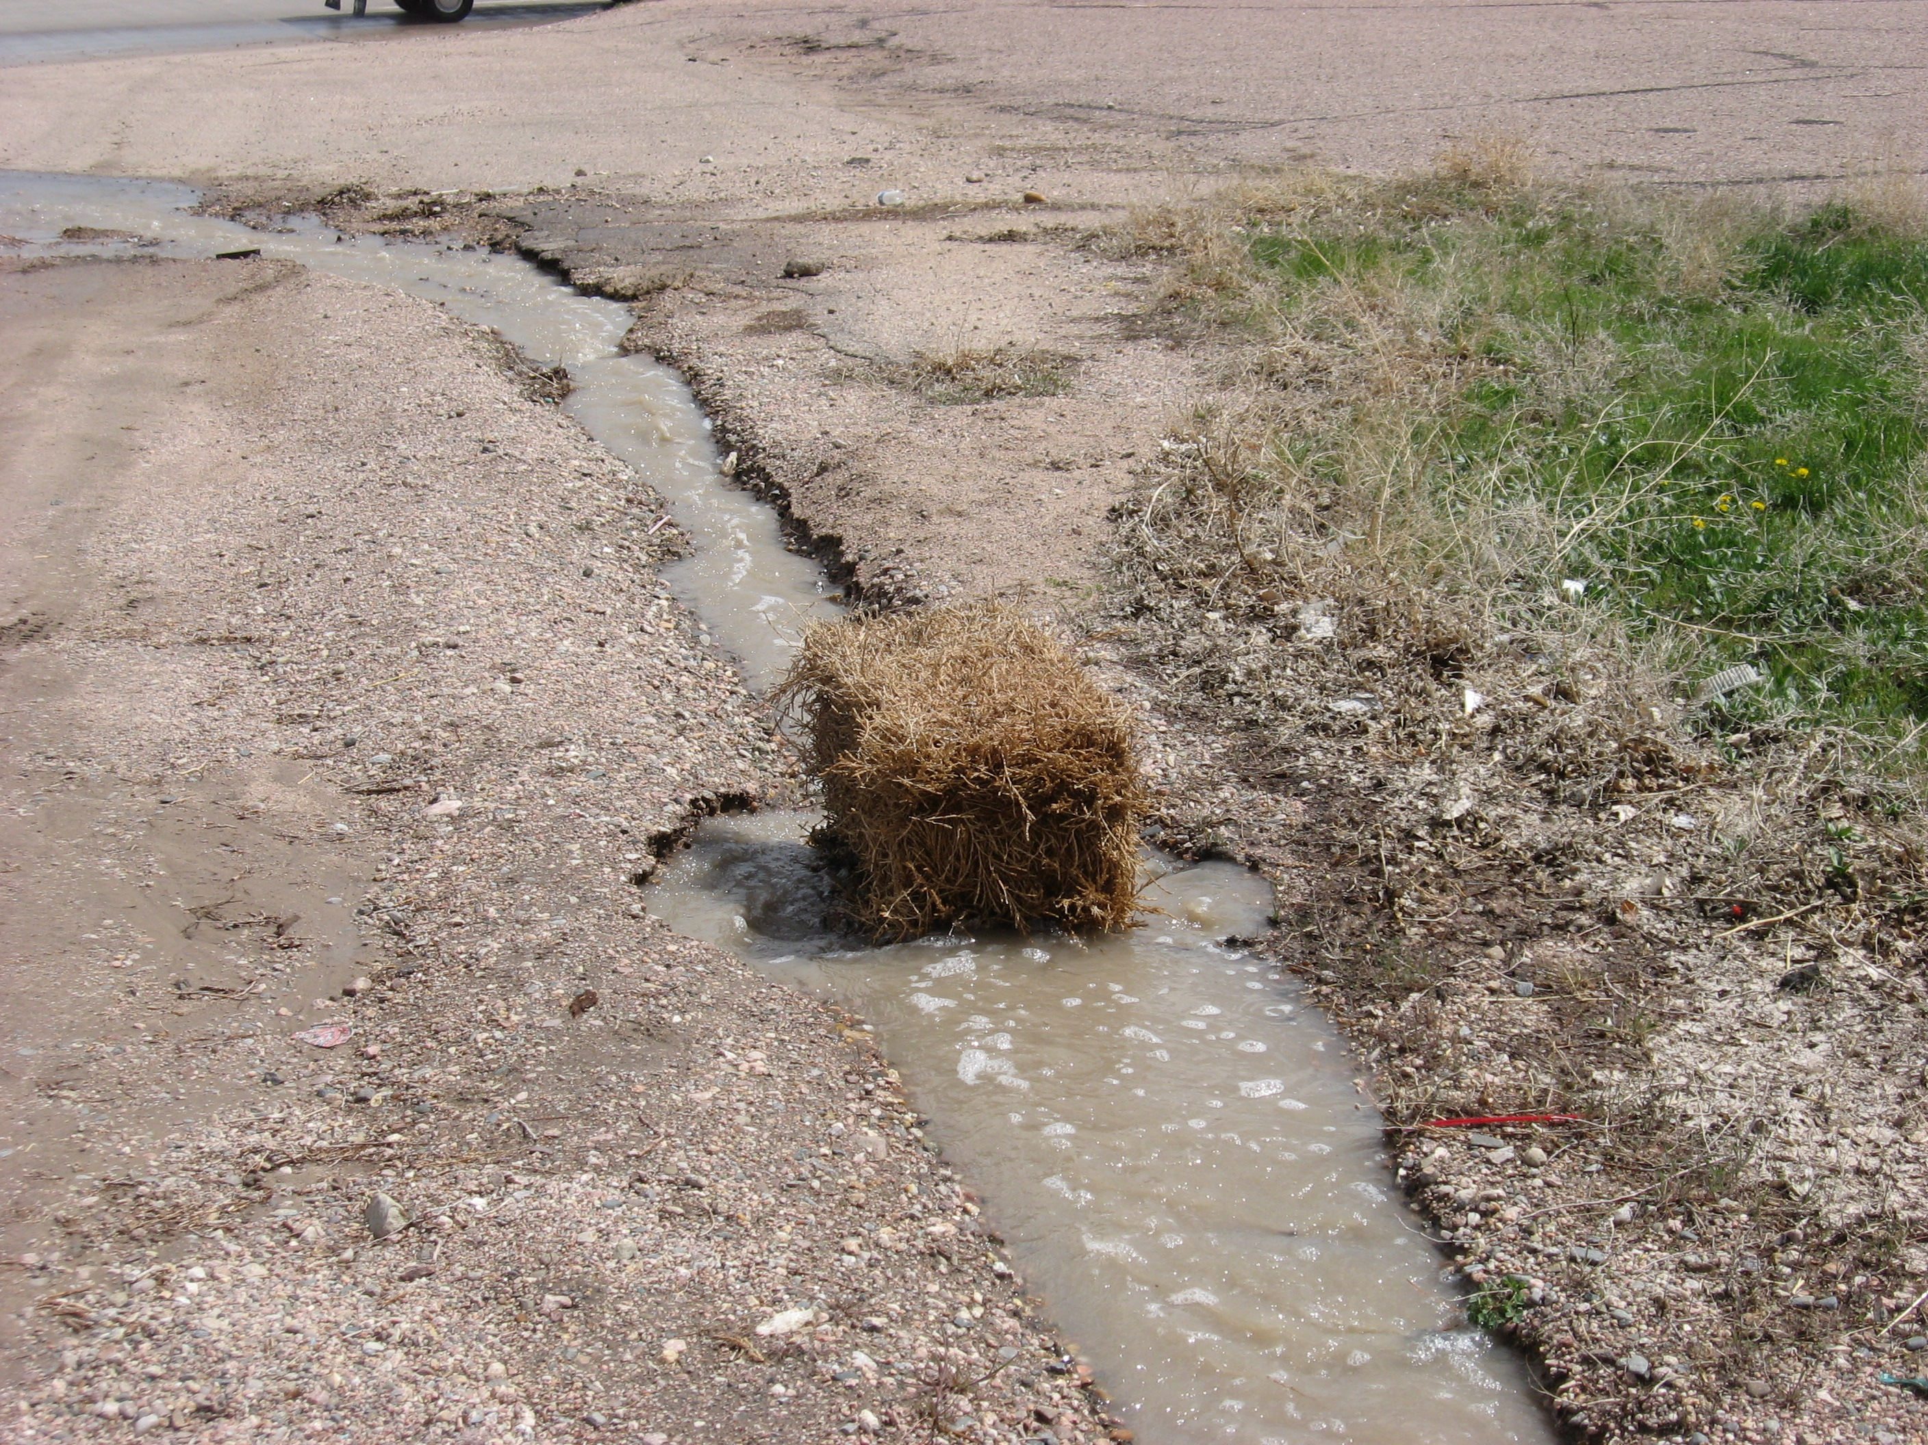
Some Additional Information

Slide 20
2 Year / 24 Hour Storm Design
BMPs must function and treat runoff in an equivalent storm
Little or no sediment should be lost from the construction site in such a storm

Slide 21
Inspections
Self inspections are required and must be documented
Active construction
  Every 7 days or 14 days plus after 0.5” precipitation
Inactive construction
  Every 30 days unless snow covered or frozen

Slide 22
Permit required until …
Site reaches “final stabilization” or
Home is sold to a homeowner
  If yard not stabilized, must leave onsite ESC and provide brochure to new owner
When final stabilization is achieved, terminate permit coverage

Slide 23
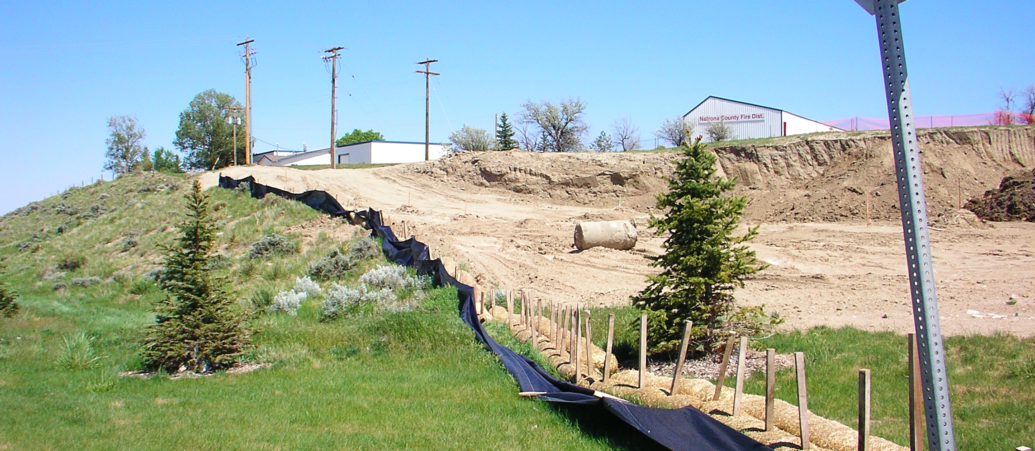
Municipal Storm Water Permit
Another layer of complication…

Slide 24
MS4 Permit
Municipal Separate Storm Sewer System
State’s permit on municipal storm sewers
  Casper and Cheyenne areas
Also part of the Clean Water Act

Slide 25
MS4 Permit
Permit requires MS4s to have their own construction program
  Regulates discharges of pollutants from construction
  Covers disturbances ≥ 1 acre (and smaller if part of a common plan)
  Most covered MS4s relying on the state’s CGP req’s

Slide 26
MS4 Permit
State and City – same message???
In general, yes

Slide 27
The End
Barb Sahl
  Barb.sahl@wyo.gov
John Gorman
  John.gorman@wyo.gov
Jessica McConnell
  Jessica.mcconnell@wyo.gov

Slide 28

Questions?

